Slide 1
Asymmetric cipher & Digital signature
Vietnam National University Ho Chi Minh City, University of Science
Department of Information Technology
Assoc. Prof. Trần Minh Triết
PhD. Trương Toàn Thịnh

Slide 2
Introduction
The problem that arises in conventional cryptosystems is the sharing of the key k between sender A and receiver B.
In fact, the need to change the contents of the key k is necessary, so the exchange of information about the key k between A and B is necessary.
To secure the key k, A and B must communicate with each other over a truly secure and secret communication channel.
However, it is very difficult to guarantee the security of the communication channel, so the key k can still be detected by person C!

Slide 3
Introduction
The idea of ​​a public key cryptosystem was introduced in 1976 by Martin Hellman, Ralph Merkle and Whitfield Diffie at Stanford University.
Subsequently, the Diffie-Hellman method of Martin Hellman and Whitfield Diffie was published.
In 1977, in the journal “The Scientific American”, the authors Ronald Rivest, Adi Shamir and Leonard Adleman published the RSA method, the famous public key encryption method and widely used today in applications of encryption and protect information

Slide 4
Introduction
A public-key system uses 2 types of keys in the same key pair:
  Public key is widely available and used in information encryption
  Private key is held by only one person and is used to decrypt information encrypted with the public key.
These coding methods exploit f mappings for which the back mapping f⁻¹ is very difficult compared to performing the f.
Only when the private key is known can the reverse mapping f⁻¹ be performed.

Slide 5





Public-key cryptosystem



Slide 6
RSA
In 1978, R.L. Rivest, A. Shamir and L. Adleman proposed the RSA public key encryption system (also known as the “MIT system”). In this method, all calculations are performed on ℤ_{n} where n is the product of two distinct odd primes p and q.
So, we have ϕ(n) = (p – 1) × (q – 1)
  Let P = C = Z_{n} and define: K = {((n, p, q, a, b): n = p × q, p, q are distinct prime numbers, a × b ≡ 1 (mod ϕ(n))}
  For each k = (n, p, q, a, b) ∈ K, let:
    e_{k}(x) = x^{b} mod n and d_{k}(y) = yª mod n, for x, y ∈ Z_{n}
  n and b are published (public-key)
  p, q, a are kept secret (private-key)

Slide 7
RSA
Generate two prime numbers with large values ​​p and q
Compute n = p × q and ϕ(n) = (p – 1) × (q – 1)
Randomly choose an integer b (1 < b < ϕ(n)) such that gcd(b, ϕ(n)) = 1
Compute a = b^{–1} mod ϕ(n) (using extended Euclide algorithm)
n and b are published (public-key)
p, q, a are kept secret (private-key)

Slide 8
Some attacks on RSA
The security nature of the RSA method is based on the fact that the cost of invalidating encrypted information will be too great to be considered impossible.
Since the key is public, RSA cracking attacks often rely on the public key to determine the corresponding private key. It is important to rely on n to calculate p, q of n, from which d can be calculated.

Slide 9
Using ϕ(n)
Suppose the attacker knows the value ϕ(n). Then the determination of the value p, q is taken to solve the following two equations: n = p × q
Let q = n/p, we have a quadratic equation: ϕ(n) = (p – 1) × (q – 1) and p² – (n - ϕ(n) + 1) × p + n = 0
p, q are the two solutions of this quadratic equation. However, the problem of detecting the value ϕ(n) more difficult than determining two prime factors of n.

Slide 10
Using factorization algorithm p-1
Algorithm (input n and B)
  a = 2
  for j = 2 to B do a = a^{j} mod n //a^{2 × 3 × … × B} = a^{B!}
  d = gcd(a − 1, n)
  if 1 < d < n then d is a prime factor of n (success)
  else cannot determine the prime factor of n (failure)
Algorithm Pollard p - 1 (1974) is one of the efficient simple algorithms used to factorize large integers. The input parameter of the algorithm is an (odd) integer n that needs to be factored into prime factors and the limit value B.
Assume n = p × q (p, q unknown) and B is a large enough integer, for each prime factor k ≤ B ∧ k | (p – 1) ⇒ (p – 1) | B!

Slide 11
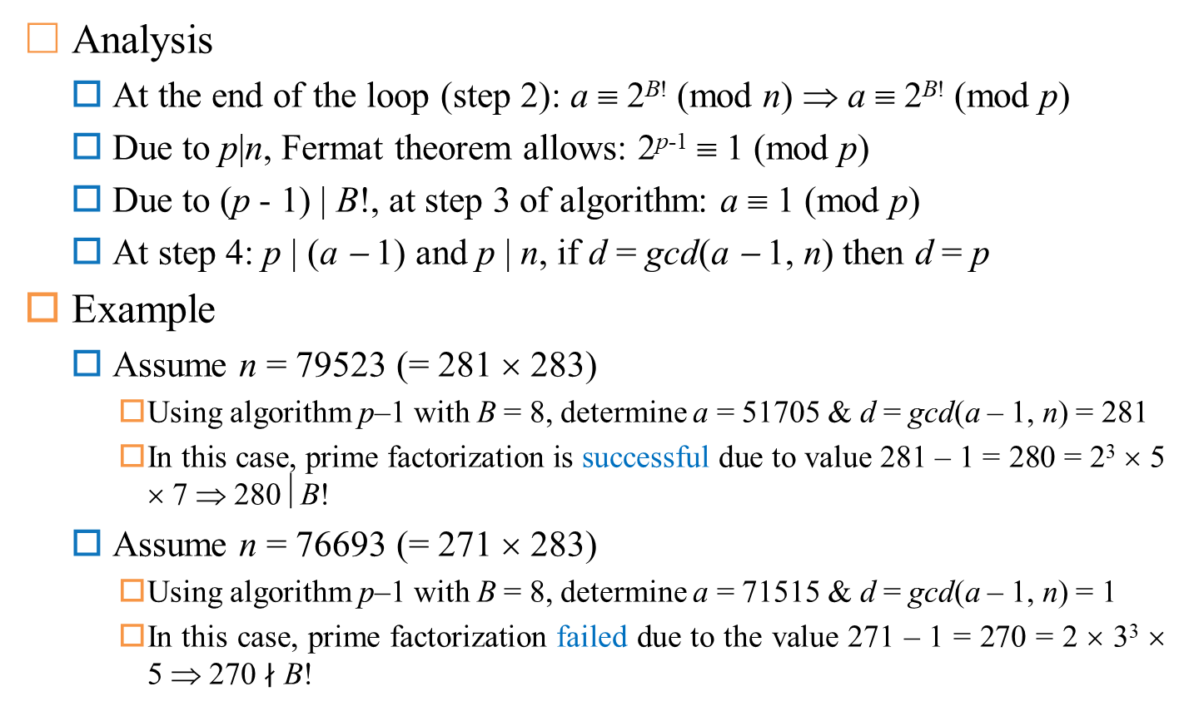
Using factorization algorithm p-1
Analysis
  At the end of the loop (step 2): a ≡ 2^{B!} (mod n) ⇒ a ≡ 2^{B!} (mod p)
  Due to p|n, Fermat theorem allows: 2^{p-1} ≡ 1 (mod p)
  Due to (p - 1) | B!, at step 3 of algorithm: a ≡ 1 (mod p)
  At step 4: p | (a − 1) and p | n, if d = gcd(a − 1, n) then d = p
Example
  Assume n = 79523 (= 281 × 283)
    Using algorithm p–1 with B = 8, determine a = 51705 & d = gcd(a – 1, n) = 281
    In this case, prime factorization is successful due to value 281 – 1 = 280 = 2³ × 5 × 7 ⇒ 280⏐B!
  Assume n = 76693 (= 271 × 283)
    Using algorithm p–1 with B = 8, determine a = 71515 & d = gcd(a – 1, n) = 1
    In this case, prime factorization failed due to the value 271 – 1 = 270 = 2 × 3³ × 5 ⇒ 270 $∤$ B!

Slide 12
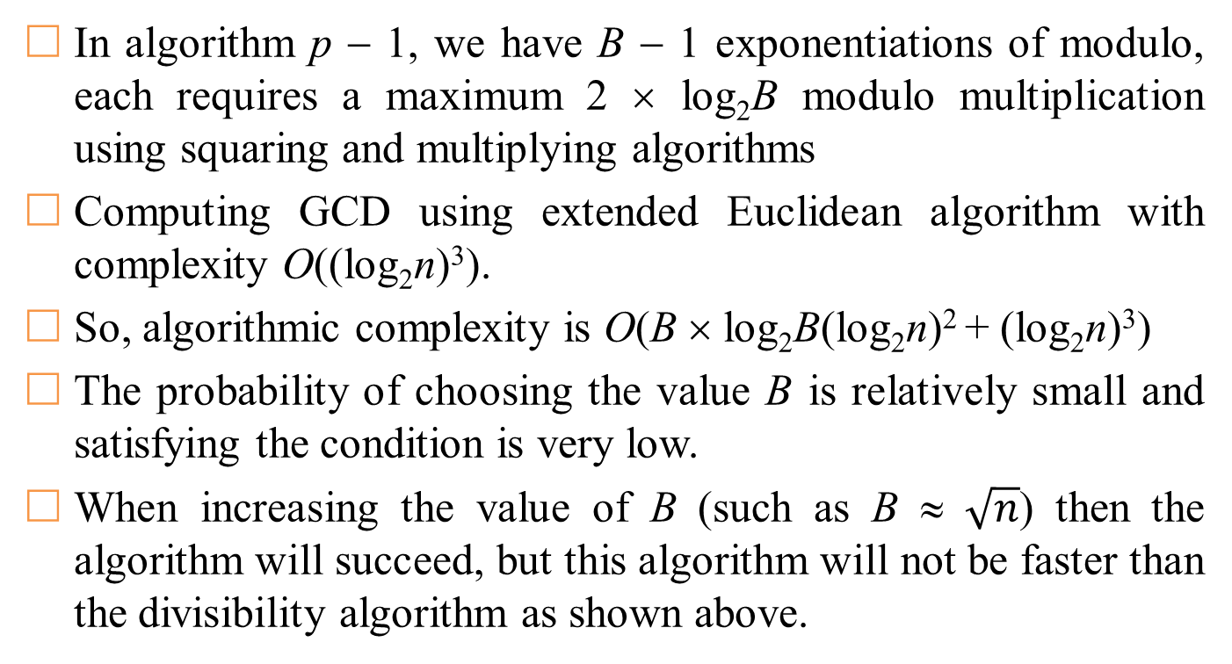
Using factorization algorithm p-1
In algorithm p − 1, we have B − 1 exponentiations of modulo, each requires a maximum 2 × log₂B modulo multiplication using squaring and multiplying algorithms
Computing GCD using extended Euclidean algorithm with complexity O((log₂n)³).
So, algorithmic complexity is O(B × log₂B(log₂n)² + (log₂n)³)
The probability of choosing the value B is relatively small and satisfying the condition is very low.
When increasing the value of B (such as B ≈ $\sqrt{n}$) then the algorithm will succeed, but this algorithm will not be faster than the divisibility algorithm as shown above.

Slide 13
Using factorization algorithm p-1
This algorithm is only effective when attacking the RSA method in the case that n has a prime factor p that (p - 1) has only very small prime divisors.
We can easily construct an RSA public-key cryptosystem that is secure against the attack algorithm p - 1. The simplest way is to find a large prime p₁, which p = 2p₁ + 1 is also prime numbers, similarly find q₁ large prime and q = 2q₁ + 1 prime.

Slide 14
Key-break based on repeat attacks
Simons and Norris: RSA systems can be vulnerable to repeated attacks. If the adversary knows public key-pair {n, e} and cipher-text C, it can compute the sequence of the following:
  C₁ = Ce (mod n)
  C₂ = C₁e (mod n)
  …
  C_{i} = C_{i-1}^{e} (mod n)
If there is a C_{j} in C₁, C₂, C₃,…., C_{i} such that C_{j} = C, then we have M = C_{j-1} because C_{j} = C_{j-1}^{e} (mod n) and C = Me (mod n)
Example: if attacker knows {n, e, C} = {35, 17, 3}, it computes
  C₁ = Ce (mod n) = 317 (mod 35) = 33
  C₂ = C₁e (mod n) = 3317 (mod 35) = 3
  Because C₂ = C ⇒ M = C₁ = 33
next C = (previous C)^{e}

Slide 15
Information hiding in the RSA system
RSA is characterized by information that is not always concealed.
Assume sender sends e = 17, n = 35. If it wants to send any data in {1, 6, 7, 8, 13, 14, 15, 20, 21, 22, 27, 28, 29, 34}, then result of encryption is the same as original data. So, M = Me mod n.
If p = 109, q = 97, e = 865 then RSA there is absolutely no hiding information, because ∀M, M = M⁸⁶⁵ mod (109 × 97)
For each value of n, there are at least 9 cases where the resulting encoding is the original source data.
We have, M = Me mod n, or: M = Me mod p & M = Me mod q (*)
  For each e, each equality in (*) have at least 3 solutions ∈ {0, 1, -1}.
  Number of unmasked messages (not changed after encryption): m = [1 + gcd(e - 1, p - 1)][1 + gcd(e - 1), q - 1]

Slide 16
Comments
The key to being able to decrypt the information is to get the p and q values ​​that make up the n value.
Given these 2 values, we can calculate ϕ(n) = (p – 1) × (q – 1) & d = e^{–1} mod ϕ(n) according to extended Euclidean algorithm.
If the integer n can be factored, i.e., the values ​​of p and q can be determined, then the security of the RSA method is no longer guaranteed.
Thus, the security of the RSA method based on computers at the present time is not capable of solving the factorization of very large integers.
In 1994, Peter Shor, a scientist at AT&T labs, came up with an algorithm that could efficiently parse very large integers on a quantum computer.

Slide 17
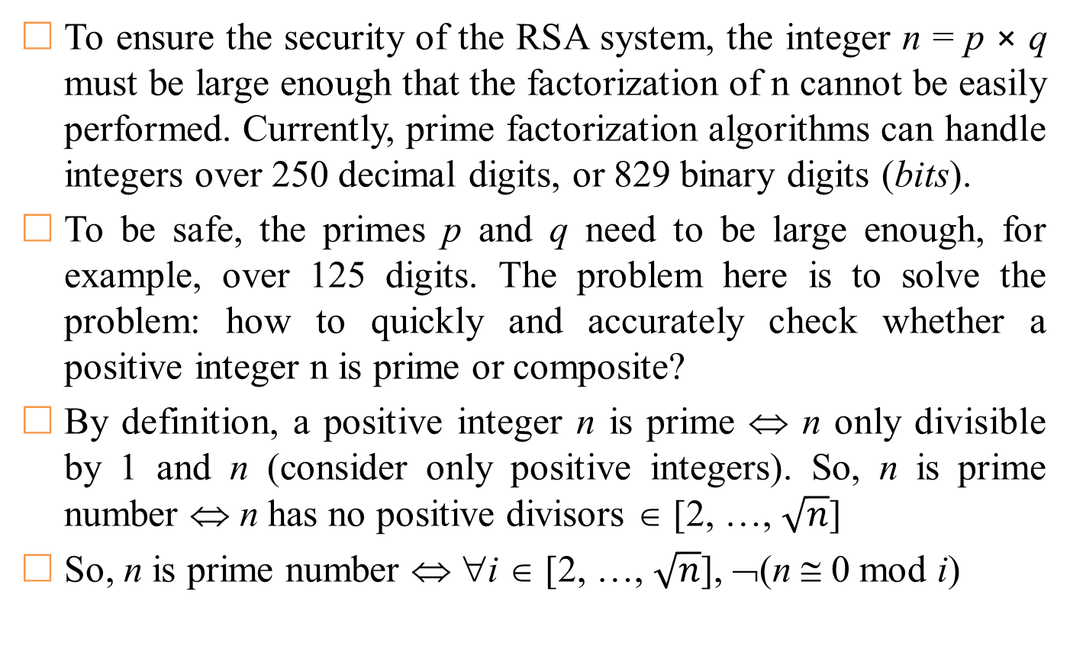
Prime number problem
To ensure the security of the RSA system, the integer n = p × q must be large enough that the factorization of n cannot be easily performed. Currently, prime factorization algorithms can handle integers over 250 decimal digits, or 829 binary digits (bits).
To be safe, the primes p and q need to be large enough, for example, over 125 digits. The problem here is to solve the problem: how to quickly and accurately check whether a positive integer n is prime or composite?
By definition, a positive integer n is prime ⇔ n only divisible by 1 and n (consider only positive integers). So, n is prime number ⇔ n has no positive divisors ∈ [2, …, $\sqrt{n}$]
So, n is prime number ⇔ ∀i ∈ [2, …, $\sqrt{n}$], ¬(n ≅ 0 mod i)
https://en.wikipedia.org/wiki/RSA_numbers

Slide 18
Miller-Rabin algorithm
Verify that a positive integer n is prime by the above method will give correct results.
However, the processing time of the algorithm is obviously very large, or even impossible, in the case of relatively large n.
In fact, verifying that a positive integer n is prime often applies methods belonging to the Monte Carlo group of algorithms
Example:
  Algorithm Solovay-Strassen
  Algorithm Miller-Rabin

Slide 19
Miller-Rabin algorithm
Monte Carlo algorithm group
  Used in the affirmation or negation of something. The algorithm always gives an answer and the answer obtained is only likely to be “Yes” or “No”.
  The “yes-biased Monte Carlo” algorithm is a Monte Carlo algorithm in which the answer “Yes” is always correct but the answer “No” may not be correct.
Miller-Rabin . Algorithm
  Advantages of fast processing (positive integer n is checked in time proportional to log₂n, i.e., a number of bits in the n’s binary representation)
  It is possible that the algorithm's conclusion is not completely correct, that is, there is a chance that a composite number n will be concluded to be prime, although the probability of the incorrect conclusion is not high.
  Overcome by executing the algorithm many times to reduce the possibility of false conclusions below the allowable threshold → highly reliable conclusions

Slide 20
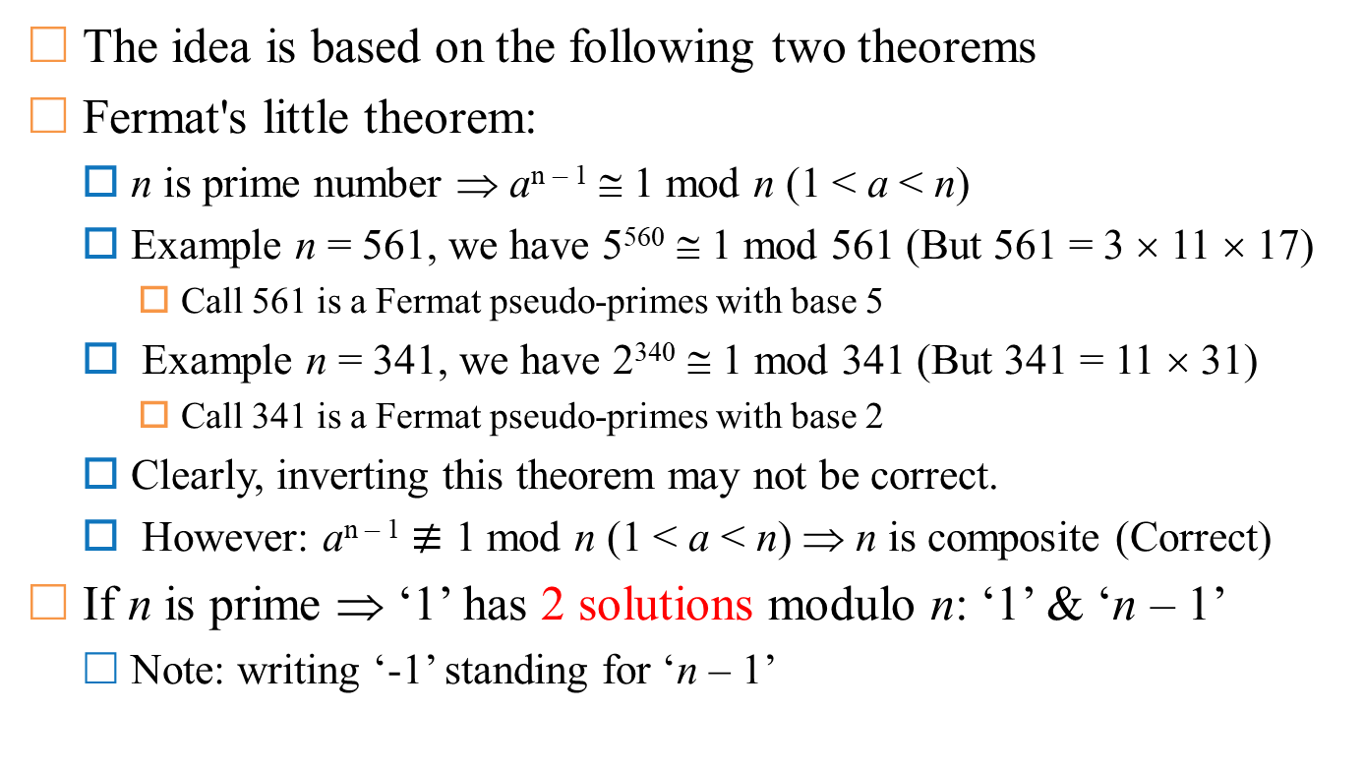
Miller-Rabin algorithm
The idea is based on the following two theorems
Fermat's little theorem:
  n is prime number ⇒ a^{n – 1} ≅ 1 mod n (1 < a < n)
  Example n = 561, we have 5⁵⁶⁰ ≅ 1 mod 561 (But 561 = 3 × 11 × 17)
    Call 561 is a Fermat pseudo-primes with base 5
  Example n = 341, we have 2³⁴⁰ ≅ 1 mod 341 (But 341 = 11 × 31)
    Call 341 is a Fermat pseudo-primes with base 2
  Clearly, inverting this theorem may not be correct.
  However: a^{n – 1} $≢$ 1 mod n (1 < a < n) ⇒ n is composite (Correct)
If n is prime ⇒ ‘1’ has 2 solutions modulo n: ‘1’ & ‘n – 1’
  Note: writing ‘-1’ standing for ‘n – 1’

Slide 21
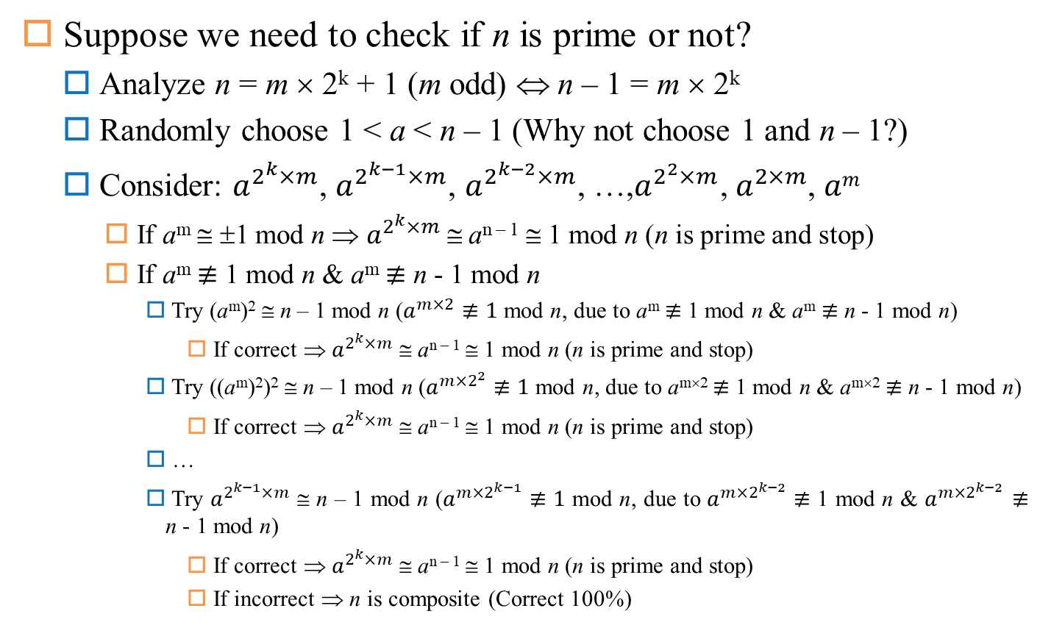
Miller-Rabin algorithm
Suppose we need to check if n is prime or not?
  Analyze n = m × 2^{k} + 1 (m odd) ⇔ n – 1 = m × 2^{k}
  Randomly choose 1 < a < n – 1 (Why not choose 1 and n – 1?)
  Consider: $a^{2^{k}×m}$, $a^{2^{k−1}×m}$, $a^{2^{k−2}×m}$, …,$a^{2^{2}×m}{\text{,} a}^{2×m}$, $am$
    If a^{m} ≅ ±1 mod n ⇒ $a^{2^{k}×m}$ ≅ a^{n – 1} ≅ 1 mod n (n is prime and stop)
    If a^{m} $≢$ 1 mod n & a^{m} $≢$ n - 1 mod n
      Try (a^{m})² ≅ n – 1 mod n ($a^{m×2}≢1$ mod n, due to a^{m} $≢$ 1 mod n & a^{m} $≢$ n - 1 mod n)
        If correct ⇒ $a^{2^{k}×m}$ ≅ a^{n – 1} ≅ 1 mod n (n is prime and stop)
      Try ((a^{m})²)² ≅ n – 1 mod n ($a^{m×2^{2}}≢1$ mod n, due to a^{m×2} $≢$ 1 mod n & a^{m×2} $≢$ n - 1 mod n)
        If correct ⇒ $a^{2^{k}×m}$ ≅ a^{n – 1} ≅ 1 mod n (n is prime and stop)
      …
      Try $a^{2^{k−1}×m}$ ≅ n – 1 mod n ($a^{m×2^{k−1}}≢1$ mod n, due to $a^{m×2^{k−2}}$ $≢$ 1 mod n & $a^{m×2^{k−2}}$ $≢$ n - 1 mod n)
        If correct ⇒ $a^{2^{k}×m}$ ≅ a^{n – 1} ≅ 1 mod n (n is prime and stop)
        If incorrect ⇒ n is composite (Correct 100%)

Slide 22
Miller-Rabin algorithm
Description: positive integer analysis n = 2^{k}m + 1 with m odd
  Randomly choose a positive integer a ∈ {1, 2, ..., n – 1}
  Compute b = a^{m} mod p
  if b ≡ 1 (mod p) then “p is prime” and stop
  for i = 0 to k − 1
    if b ≡ p − 1 (mod p) then “p is prime” and stop
    else b = b² mod p
  Conclude “p is composite”
Comments:
  A “yes-biased Monte Carlo” algorithm for the statement “positive integer n is composite”.
  The probability of the wrong conclusion, i.e., the algorithm making the conclusion “n is prime” when n is indeed composite, is only 25%.
  If we apply the algorithm k times with different values ​​of a and we still get the conclusion “n is prime”, then the correct probability of this conclusion is 1 - 4^{-k} → 1, with large-enough k.

Slide 23
Arithmetic processing
Compute z = x^{b} mod n
Algorithm “squared and multiplied”
  Let b be b_{l-1}b_{l-2}...b₁b₀, b_{i}∈{0, 1}, 0 ≤ i < l
  z = 1
  x = x mod n
  for i = l - 1 down to 0
    z = z² mod n
    if b_{i} = 1 then z = z × x mod n

Slide 24
Symmetry vs asymmetry
Conventional encryption methods have the advantage of being very fast compared to public key encryption methods.
  Because the key used for encryption is also used for decryption, it is necessary to keep the contents of the key and the key secret, called the secret key. Even in the case of a direct exchange of keys, the key is still detectable. The difficult problem for these encryption methods is the key exchange problem.
The public key is more vulnerable than the secret-key.
  To find the secret key, the decryptor needs some more information related to the characteristics of the source text before encrypting to find the decryption clue instead of having to use the key extraction method.
  Determining whether the message after decryption is indeed the original message before encryption is again a difficult problem.
  For public keys, cracking is completely possible provided there are enough resources and processing time.

Slide 25
Symmetry vs asymmetry
Cost
64
128
256
512
1K
2K
4K
Key-length (bits)
Graph comparing the cost of breaking secret-keys & public-keys

Slide 26
Contents
Introduction
RSA signature
DSA signature
One-time signature (Rabin method)
Notes:
Arbitrated signature schemes require a TTP for signature generation and verification, which results in computational generation and verification.
With added functionality such as blind, undeniable and fail-stop signature schemes

Slide 27
Introduction
Goals of digital signature:
  User authentication
  Data integrity
  Non-repudiation
Basic concepts:
  Digital signature: data string that allows to identify the origin/entity that generated a message.
  Algorithm for generating digital signatures: methods for generating digital signatures
  Digital signature strategy includes algorithm generating digital signature and algorithm verifying digital signature.
  Digital signature scheme = Digital signature generation algorithm + Digital signature verification algorithm

Slide 28
Introduction
Notations:
  M Message-space
  M_{S} Signed-message space
  S Signature-space
  R Map 1-1 from M to M_{S} (redundancy function)
  M_{R} Image of R
  R⁻¹ Inverse function of R
  h One-way function with a source set M
  M_{h} Hash-value space (h: M→ M_{h})

Slide 29
Introduction
Classification of digital signatures
Random
Restore
message
Determined
Signature
strategy
Random
Appendix
Determined

Slide 30
Introduction
s* = S_{A,k}(m_{h})
u = V_{A}(m_{h}, s*)
Signature strategies with appendix
  Signature accompanies original message (Ex: DSA, ElGamal, Schnorr…)
  Message (original) required for digital signature verification
  Use a cryptographic hash function (instead of a redundancy function)
M
M_{h}
S
h
S_{A,k}
m
m_{h}
s*
M_{h} × S
V_{A}
u ∈ {true, false}
Notes:
More commonly used

Slide 31
Introduction
s* = S_{A,k}(m_{h})
u = V_{A}(m_{h}, s*)
Requirements:
  For each k ∈ R, easy to compute S_{A,k}
  Easy to compute V_{A}
  Hard for those are not signer to find m ∈ M and s*∈ S such that V_{A}(m’, s*) = true, for m’ = h(m)
M
M_{h}
S
h
S_{A,k}
m
m_{h}
s*
M_{h} × S
V_{A}
u ∈ {true, false}

Slide 32
Introduction
A digital signature can allow the message to be recovered
M
M_{R}
S
R
S_{A,k}
m
m_{r}
s*
M_{S}
S
M_{R}
M
V_{A}
R⁻¹
s*
m_{r}
m

Slide 33
Introduction
Requirements:
  For each k ∈ R, easy to compute S_{A,k}
  easy to compute V_{A}
  Hard for (computationally infeasible) those are not A to find s* ∈ S such that V_{A}(s*) ∈ M_{R}
M
M_{h}
M_{R}
S
h
R
S_{A,k}
m
m_{h}
m_{r}
s*
M_{S}

Slide 34
Introduction
Levels of “Breaking” the e-signature strategy:
  Total Break: find an efficient way to “fake” a valid signature.
    Know private key?
    Do not know private-key but find an efficient way to create a valid signature.
  Selective forgery: Given a message, attacker can create a valid signature for this message.
  Existential forgery: can find and point to a message (maybe nonsense) but easy for attacker to create valid signature for this message.
Classification of attacks
  Key-only: attacker only know public-key
  Message attack
    Known-message attack: attacker has the signatures of a set of messages. Attacker knows contents of these messages but is not allowed to pre-choose these messages.
    Chosen-message attack: attacker has valid signatures of a set of selective messages (non-adaptive)
    Adaptive chosen-message attack: attacker can use signer as a “oracle”
Severity
Notes:
Total break can simply occur if the adversary finds an efficient algorithm that is functionally equivalent to the valid signing algorithm

Slide 35
RSA signature
Generate key n, p, q, e, d
Create signature
  Compute m_{r} = R(m)
  Compute s = m_{r}^{d} mod n
  Signature of m is s
Verify signature
  Receive public-key (n, e)
  Compute m_{r} = s^{e} mod n
  Verify m_{r} ∈ M_{r}
  Recover m = R⁻¹(m_{r})
Notes:
n, e are public, p q and d are private. d = e inverse mod phi(n)

Slide 36
RSA signature
Attack
  Factorize a large integer
  Possibility of multiple key pairs yielding the same signature
  Homomorphic property:
  E(x₁) × E(x₂) = x₁e× x₂e mod n = (x₁ × x₂)^{e} mod n = E(x₁ × x₂ mod n)
Re-blocking problem
Importance of redundancy function: ISO/IEC 9796
Efficiency (p, q are k-bit prime-numbers): cost of generating signature O(k³) and verifying signature O(k²)
Bandwidth
  Bandwidth depends on R.
  Example: ISO/IEC 9796 maps a k-bit message to a 2k-bit string in M_{S} with 2k-bit signature.
Notes:
For s1 and s2, we have that s1s2 is a signature for m1m2 given that m1m2 is an element of the image of the redundancy function. Thus it is important that our redundancy function is not multiplicative.
Various solutions to this problem, one effective solution is to ensure that each modulus is of a special form. Or have one set t bits for signing and one set t+1 bits for encrypting.
Where k is the number of bits in p and q.

Slide 37
DSA signature
Generating key:
  Choose 1 prime number q 160 bits
  Choose 0 ≤ t ≤ 8, choose 2^{511 + 64t} < p < 2^{512 + 64t} for q | p – 1
  Choose g in Z_{p}*, and α = g^{(p - 1) / q} mod p, α ≠ 1 (α is a primitive of sub-group with order q of Z_{p}*)
  Choose 1 ≤ a ≤ q - 1, compute y = αª mod p
  Public-key (p, q, α, y) and private-key a
Create signature:
  Randomly choose an integer k, 0 < k < q
  Compute r = (α^{k} mod p) mod q and k⁻¹ mod q
  Compute s = k⁻¹ × (h(m) + a × r) mod q
  Signature = (r, s)
Notes:
Two primes p and q. We are dealing with two groups, one Z*p and a subgroup of that of order q. Here alpha is a generator of that subgroup. Notice that the security of our key is based on the discrete logarithm problem.

Slide 38
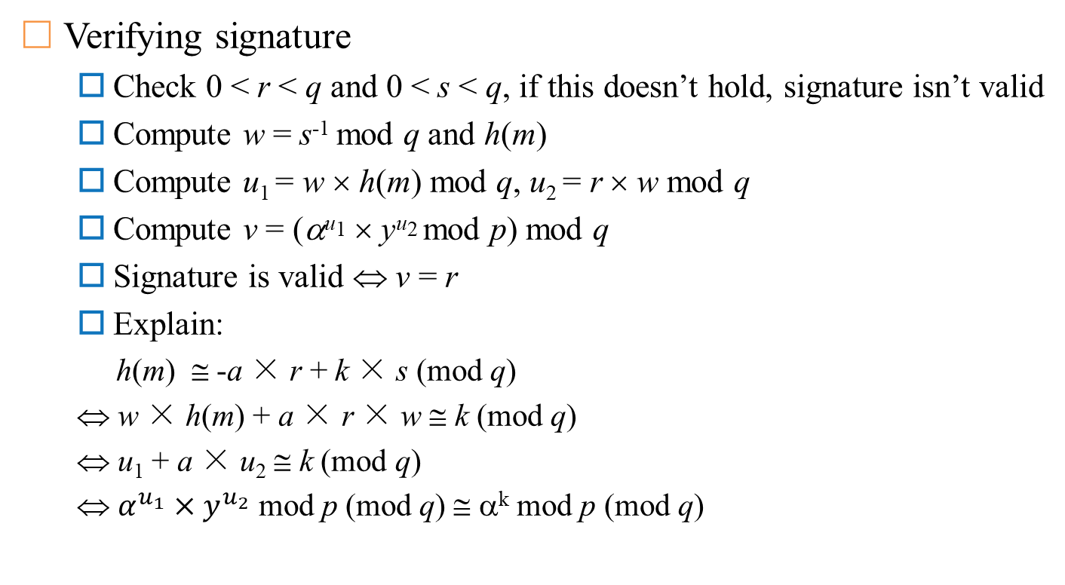
DSA signature
Verifying signature
  Check 0 < r < q and 0 < s < q, if this doesn’t hold, signature isn’t valid
  Compute w = s⁻¹ mod q and h(m)
  Compute u₁ = w × h(m) mod q, u₂ = r × w mod q
  Compute v = (α^{u1} × y^{u2} mod p) mod q
  Signature is valid ⇔ v = r
  Explain:
  h(m) ≅ -a × r + k × s (mod q)
  ⇔ w × h(m) + a × r × w ≅ k (mod q)
  ⇔ u₁ + a × u₂ ≅ k (mod q)
  ⇔ $α^{u_{1}}×y^{u_{2}}$ mod p (mod q) ≅ α^{k} mod p (mod q)

Slide 39
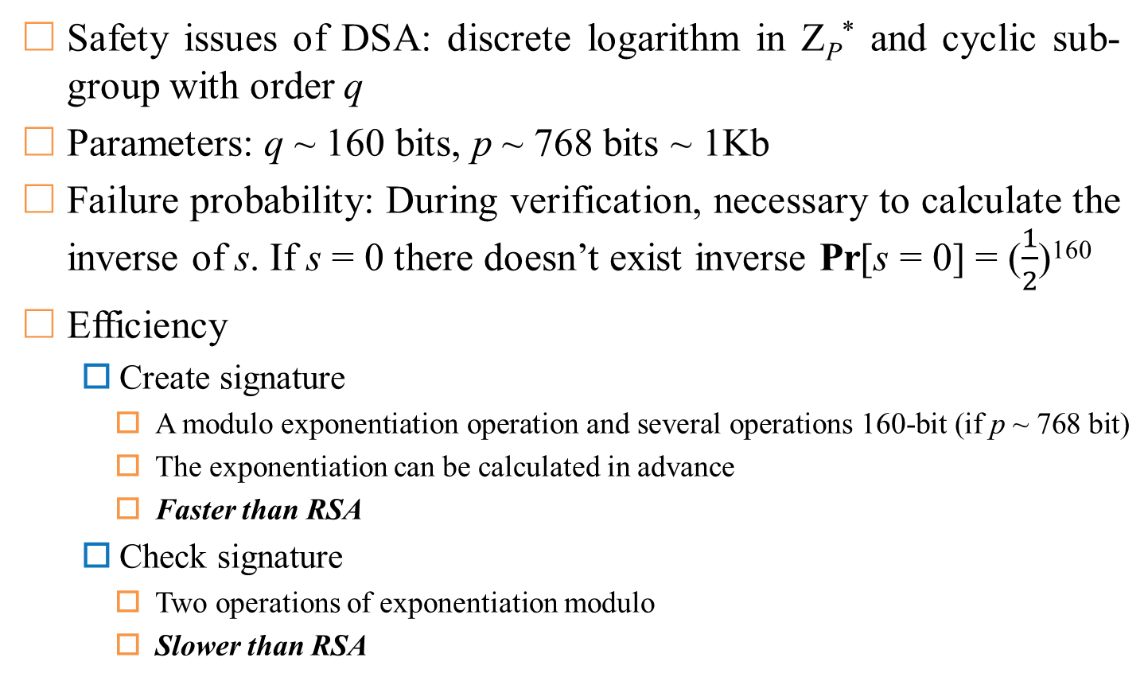
DSA signature
Safety issues of DSA: discrete logarithm in Z_{P}* and cyclic sub-group with order q
Parameters: q ~ 160 bits, p ~ 768 bits ~ 1Kb
Failure probability: During verification, necessary to calculate the inverse of s. If s = 0 there doesn’t exist inverse Pr[s = 0] = ($\frac{1}{2}$)¹⁶⁰
Efficiency
  Create signature
    A modulo exponentiation operation and several operations 160-bit (if p ~ 768 bit)
    The exponentiation can be calculated in advance
    Faster than RSA
  Check signature
    Two operations of exponentiation modulo
    Slower than RSA
Notes:
Note that Z*p we have the index-calculus methods such as coppersmiths algorithms which run in subexponential time. However, in the second group we are left with “square root” time with algorithms such as Pohlig Hellman
Verification requires the computation of s inverse, if s is zero then an inverse does not exist

Slide 40
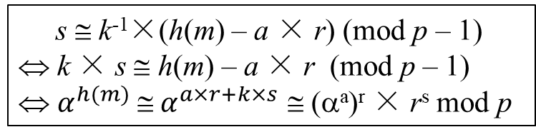
ElGamal signature
Generate key: p, q, α, a, y = αª mod p
  α is a primitive of Z*_{p}
  Public-key (p, α), private-key (a)
Create signature
  Randomly choose k, 1 ≤ k ≤ p - 1, gcd(k, p - 1) = 1
  Compute r = α^{k} mod p, k⁻¹ mod (p-1) and s = k⁻¹ × (h(m) - a × r) mod (p-1)
  Signature (r, s)
Check signature
  Check 1 ≤ r ≤ p – 1
  Compute v₁ = y^{r}× r^{s} mod p, h(m) and v₂ = α^{h(m)} mod p
  Signature is valid ⇔ v₁ = v₂
  s ≅ k⁻¹×(h(m) – a × r) (mod p – 1)
  ⇔ k × s ≅ h(m) – a × r (mod p – 1)
  ⇔ $α^{h(m)} \text{≅} α^{a×r+k×s}$ $\text{}$ (αª)^{r} × r^{s} mod p
Explain
Notes:
Here alpha is a generator of Z*p
p alpha and y are public and a is private key
Again, this is randomized as apposed to deterministic

Slide 41
ElGamal signature
Problems
  Value k must be distinguished for each signed message
    (s₁ - s₂) × k = (h(m₁) - h(m₂)) mod (p - 1)
    If gcd((s₁ - s₂), p - 1) = 1 then can determine the value k, and have private-key a
  If you don’t use the hash function, you may get an existential forgery
Efficiency
  Create signature
    An exponentiation operation modulo
    An operation that uses the Euclidean algorithm to compute the inverse
    Two multiplication operations modulo
  Check signature: three exponentiation operations modulo
Read more: Generalized ElGamal Signature
Notes:
If gcd((s1-s2),p-1)=1 then we can easily find k and from there we can find private key a
p. 255

Slide 42
One-time signature (Rabin method)
Definition: the signature strategy is used to sign up to one message
  If reused, can be hacked to create fake signatures.
  A new public key is required for each message to be signed
Most one-time signature strategies are characterized by very fast signature generation and verification
Create key: choose symmetric encryption algorithm E (ex: DES)
  Generating 2n random string k₁, k₂ ..., k_{2n} ∈ K, each has length of l
  Compute y_{i} = E_{ki}(M₀(i)), i ∈[1, 2n])
    M₀(i) is the binary representation of i filled with more bits 0 at the beginning to get the sequence l-bit
  Public key is (y₁, y₂, ... y_{2n}) and private key is (k₁, k₂, ... k_{2n})

Slide 43


One-time signature (Rabin method)
If there is a conflict, there is a need Trusted Third Party (TTP)
  Signer may deliberately deny having created the signature
  Verifier may deliberately not accept the signature
  …
Signer
Verifier
  Compute s_{i} = E_{ki}(h(m)), i ∈ [1, 2n]
  Signature (s₁, s₂, ..., s_{2n})
1
  {m, (s₁, ..., s_{2n})}
2
  Compute h(m)
  Randomly choose distinct n number of r_{j} ∈ [1, 2n]
  Need n keys k_{rj}, ∀j: 1 ≤ j ≤ n
3
  n keys k_{rj}, ∀j: 1 ≤ j ≤ n
  Check n keys y_{rj}?= E_{krj}(M₀(r_{j}))
  Check all s_{rj} = E_{krj}(h(m))
4
  {Accept or reject}
Notes:
Here note that we are using n or half of 2n, the original number of keys

Slide 44


One-time signature (Rabin method)
Context: Signer refuse to generate signature provided by Verifier
Signer
TTP
  {k₁, ..., k_{2n}}
  {m, (s₁, ..., s_{2n})}
Verifier
Check private-key {k₁, k₂, …, k_{2n}}
1
If this doesn’t hold, TTP judge Verifer thắng
2
Compute u_{i} = $E_{k_{i}}$(h(m)), 1 ≤ i ≤ 2n
If there are at most n quantities u_{i} = s_{i}
3
There are at least n + 1 quantities u_{i} = s_{i}
Fake signature (Signer thắng)
Real signature (Verifier thắng)
Notes:
B cannot provide more than n encrypted values because it does not have another key or find a collision in the hash function
A would need to find n values such that ui equals si and hope that B chooses these values.

